Slide 1
School of Electrical, Computer, & Energy Engineering
Hosted By Business Operations Team

Slide 2
Agenda
Human Resources
Student Hires: Offer Letters and Timelines
Business Ops Duties/Assignments
Social Security Number Application
Travel Process
Domestic & International
TAR Form & Concur Request
After Travel Procedures
Purchasing and Additional Services
Purchase & Reimbursement Requests
FedEx Shipping
Key Requests & ISAAC Access (Key Fob System)
Conference Room Reservations

Slide 3
ECEE Business Office
Location: GWC, 208
Office Hours: 8:00am- 4:00pm Monday - Friday
Mail Code: 5706
Physical Address: 650 E Tyler Mall, GWC 208 Tempe, AZ 85281 -5706
Shipping Address: 734 W ALAMEDA DR (ALMDBR), ALAMEDA RECEIVING, Tempe, AZ 85282

Slide 4
Services Provided by ECEE Business Ops Team
Order and purchase requests
Order follow-up
Reimbursements
Review and Approves Travel Request/Travel Expense Reports
FedEx Labels/Schedule a Pickup
Payroll and Offer Letters

Slide 5
Human Resources
This section will cover
Student Hires: Offer Letters and Timelines
Business Ops Duties/Assignments
Social Security Number Application
Presented By Adriana Nieves, Department HR Manager

Slide 6
When to Contact the Business Ops Team
Managed by the Assigned Business Operations Specialist/Specialist Sr.
All non-faculty hires
Hourly student hires and GRA/GSA positions
Payroll-related issues
Monitoring and maintaining immigration status eligibility for department positions (including ACA position reporting)
Managed by Specific Individuals:
Graders: Katarina Velez and Michelle Fitch
TAs: Sabrina Beck
Dean’s/Fulton Fellows (1st Year) UGF, Postdocs, AP, and Non-tenure hires: Loren Benally
business specialist assignments can be found https://ecee.engineering.asu.edu/business/ below instructions of each tab.

Slide 7
Offer Letters and Timelines
Please wait until the offer letters have been signed and implemented before starting to work.
Offer letters can be expected beginning at least one week prior to start date.

Slide 8
Employment Offer Letter for Social Security Number Application
Contact your Assigned Business Operations Specialist/Specialist Sr.
The Employment verification letters can be completed once letters are issued for positions (GRA-GSA-TA)
You must pick up the letter in person, as the letters must be ink signed by a Business Ops Specialist

Slide 9
Helpful Links
Payday calendar 2024
Payday calendar 2025
ISSC Links
Visas
Social Security Number Application Process
On Campus Employment - F1/J1

Slide 10
Travel
This section will cover
Travel Process
Domestic & International
Flying vs Driving
TAR Form & Concur Request
How to access MY ASU Trip/Concur
After Travel Procedures
Presented By Michelle Fitch, Business Operations Specialist

Slide 11
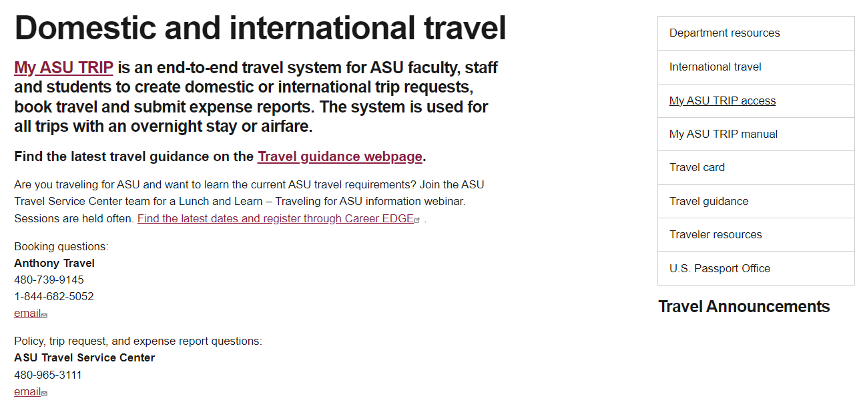
My ASU TRIP

Slide 12
Driving vs Flying
International Travel
If driving for personal reasons, pull a RT flight comparison
You can claim mileage up to the cost of the cost of the flight.
Can only claim the mileage, fuel is not reimbursable. Minimal amount is allowed to be claimed for parking.
If driving for business purposes, add a business justification
Rental car is allowed if the business purpose cannot be accomplished with a personal vehicle.
Must be an ASU Authorized Driver.
Any students or faculty traveling with students (group travel) must register travel with the Student International Travel Registry.
Student Internation Travel Registration System
Submit travel at least 2 weeks prior to travel.
Any travel approved 60+ days prior to travel date, ITAC will review 30 days prior to travel.
GEO will not approve Concur request if international travel is not approved by ITAC.
GEO- Global Education Office
ITAC- International Travel Advisory Committee
What is Concur Travel
and What is In-State Travel
Concur Travel is
Any travel with Airfare or an overnight stay
In-state travel is considered
More than 50 mile from ASU duty post.
Includes an overnight stay.

Slide 13
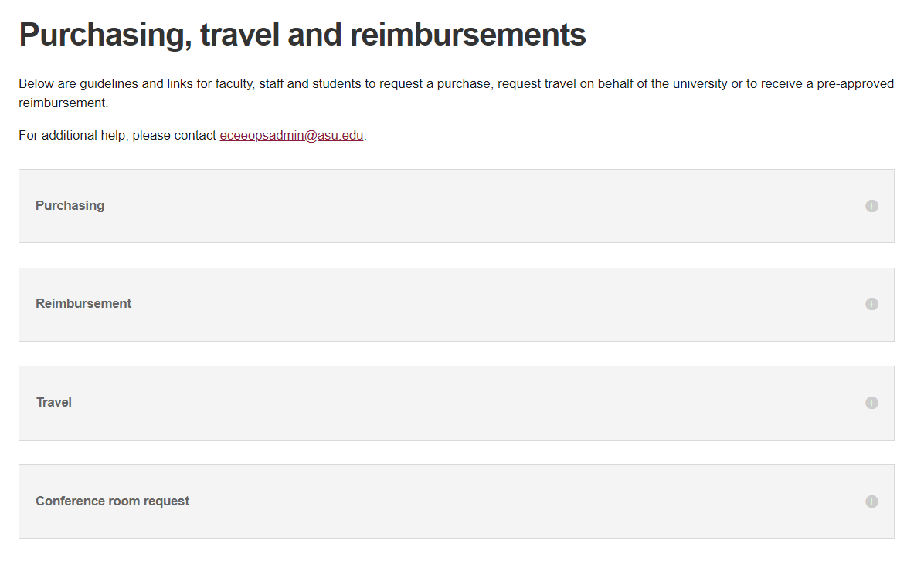
Start here!
ECEE Business Office Purchasing, Travel and Reimbursements

Slide 14
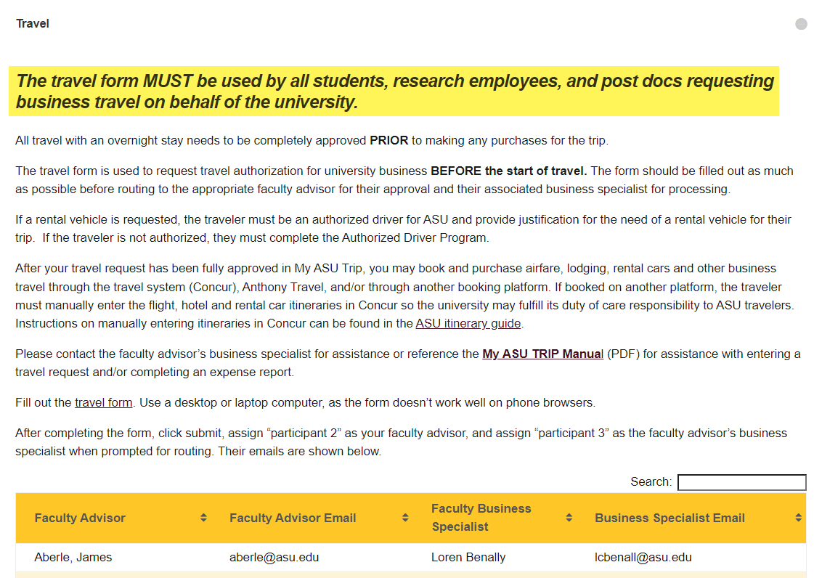
Not required for faculty
Airfare and/or an overnight stay is considered travel and must go through Concur
TAR form AND Concur request must be approved prior to travel
Access Travel Authorization Request Form here

Slide 15
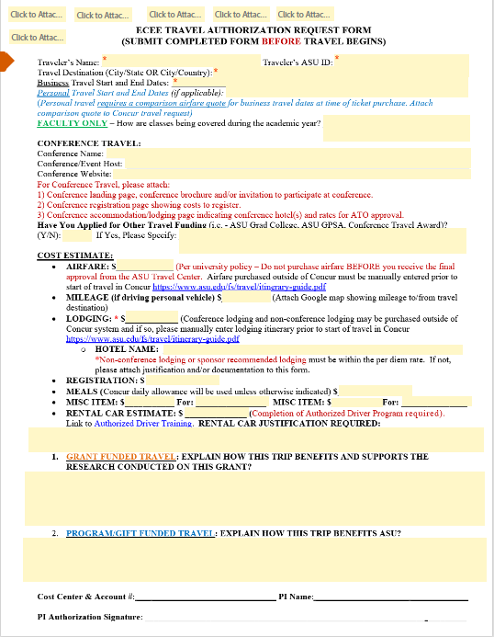
Information needed to completed TAR (Travel Authorization Request) form
Name, ASU ID#
Destination City/State or City/Country
Travel start and end dates
ASU allows 1 day for travel on both departure and arrival day
ASU allows 2 days for travel on international flights
Date of personal travel, if any
Flight comparison for RT PHX-Destination for business days only
Name of Conference/meeting
Event host
Website
If applicable-any other funding (Grad College, GSG (previously GPSA), Conference Award)
Estimated costs
Airfare
Mileage
Lodging – name of hotel
Registration
Misc. Expenses (poster printing, Ubers, airport parking, etc.)
Rental Car- business justification required
Must complete “Authorized Driver Training” prior to travel
Grant Travel- how does this travel benefit/support research on the grant
Program Travel- how does this travel benefit ASU
Attach conference landing page, conference brochure or invite to support travel days
Attach registration page to show costs of registration
Attach conference accommodations/lodging page indicating conference hotel and cost
List PI as Participant 2 and Business Operations Specialist and Participant 3
Once approved, you will need to enter your Concur request

Slide 16
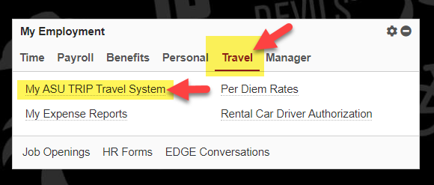
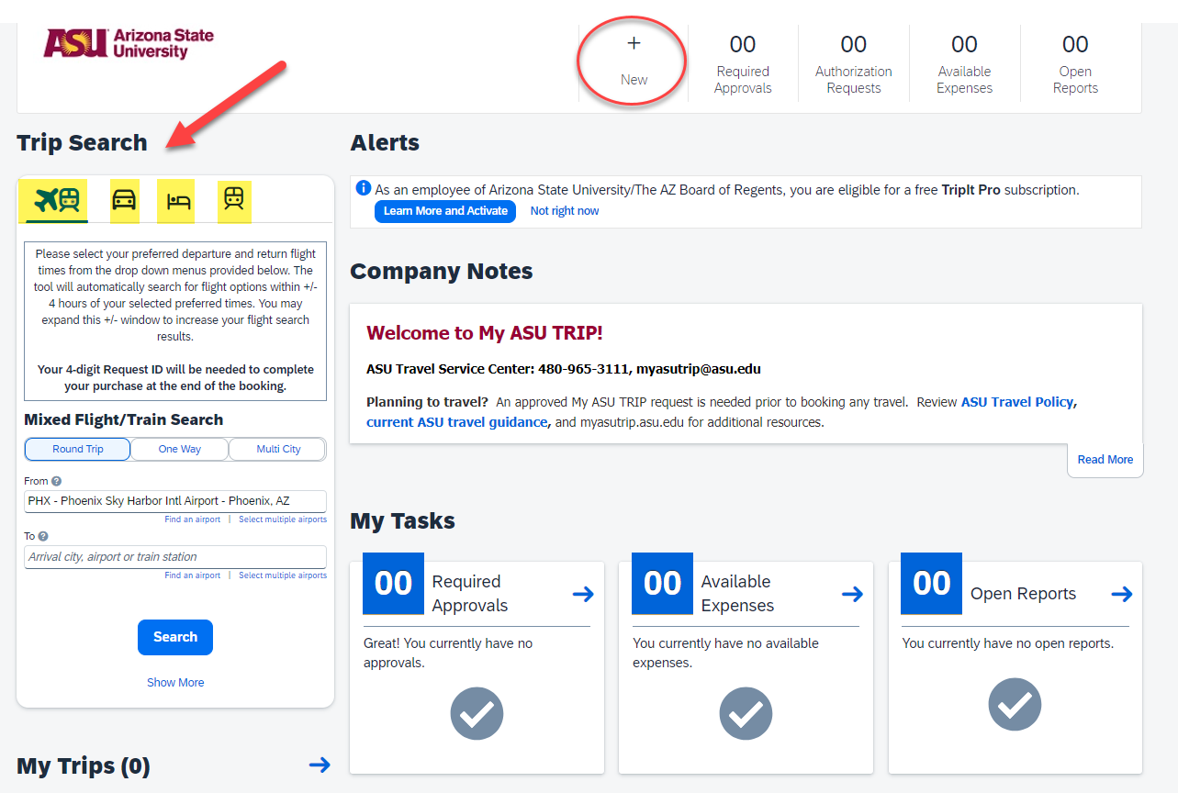
How to access MY ASU Trip/Concur
My ASU:
Purchase flights, hotel, car rental and hotels within Concur

Slide 17
Creating Concur Request
Once your TAR form has been approved, you will need to complete the Concur request. Once the request has been approved, you will be fully authorized to travel.
My ASU Trip Manual has step by step instructions on completing your request. My ASU TRIP
Start your request- header information can be found on your TAR form. (Dates, funding, etc.)
Enter only business dates, personal dates if any, should be listed in the comment section.
Enter expenses listed on your TAR form.
Attach your approved TAR form, conference brochure, and flight comparison if required.
If a cash advance is needed, it must be requested before the trip request is approved (you can request 75% of the request amount, minus airfare and conference registration. Minimum amount allowed is $200).
Undergraduate students will need to request a Concur profile.
Request should be submitted to the faculty Business Operations Specialist.
Once request is approved, you may purchase airfare, reserve lodging, etc.
It is recommended that airfare be purchased in Concur but is not required. There is no out-of-pocket expense when purchasing in Concur as there is an airfare card in every Concur profile.
Rental cars should be reserved in Concur. Contracted vendors are Enterprise, National and Hertz. If not reserved in Concur, be sure to use the State of Arizona contract as our contract will include insurance. On international car rentals you should always purchase the liability insurance.
Lodging can be reserved in Concur or directly with the hotel. To use a conference rate, you will need to reserve directly with hotel/conference organizer.
Try to keep hotel rate under the daily allowed amount. If over the allowed amount, you will need to provide a justification. Conference hotel rates are allowed/exception.

Slide 18
After Travel
Expense reports are due within 30 days after the end of travel.
My ASU Trip Manual has step by step instructions on completing your report. My ASU TRIP
Start expense report from request:
Policy Required Receipts:
Airfare (Name, dates, destination, class
of service.)
Lodging
Name of Traveler
Hotel Name & Address
Check-in and Check-out Dates
Itemized Expenses
Proof-of-payment
Rental Car
Business Meals
Out-of-Pocket Expenses over $50.00
Expense Report Notes:
Enter your itinerary first! Use the city your lodging is located, not the location you flew into.
Opt out of any provided meals (hotel, conference, flight, business meals)
Daily allowances are reduced to 75% on departure and arrival days
Include to/from on all Taxi/Uber/Lyft rides
Uber/Lyft reservations, XL, and/or SUV will require business justification.
Tipping is limited to no more than 20%
Flights purchased in Concur with the airfare card must be added to the report. It will not reimburse the traveler, but all airfare card purchased flights will need to be reconciled.
*All receipts MUST show proof-of-payment

Slide 19
Useful links and information
My ASU TRIP
ECEE Business Office Purchasing, Travel and Reimbursements
Student Internation Travel Registration System
Per-Diem Allowances
ASU Travel Policy
Print My Concur Invoice
ASU Authorized Driver Training
Please remind your travelers to contact Anthony Travel directly if there are any issues with their airfare after the
airfare has been booked/purchased in CONCUR. This could be necessary either before the trip starts or during their trip.
This would include situations like needing to make changes to their flight, if a flight was canceled, if their flight was
delayed and they missed their connecting flight, etc. ASU travelers should be working directly with Anthony Travel to
resolve any issue with their airfare instead of trying to fix the issue on their own with the airlines.
Anthony Travel
Business Hours (Mon – Fri 8am – 5pm PST)
Phone: 480‐739‐9145
After Hours Emergency Domestic
Phone: 800‐342‐9008
After Hours Emergency International
COLLECT: 817‐358‐8606
DIRECT: 682‐233‐1914

Slide 20
Purchasing and Additional Services This section will cover General Business Office Info/Services Provided Key Requests ISAAC Access (Key Fob System) Purchase Request Reimbursement Request Conference Room Reservation FedEx Shipping
Presented By Talia Medina, Business Operations Specialist Sr.

Slide 21
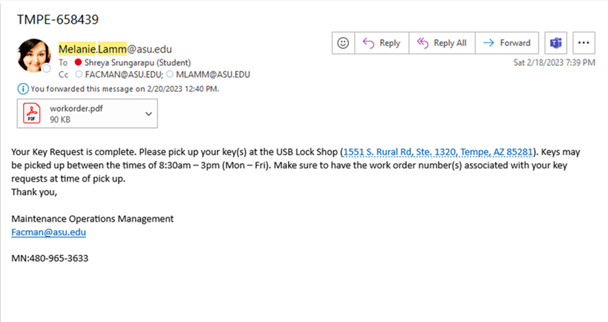
Key Request
Key request form – Scroll Down to Key Request and select the complete the key request that aligns best. To process this request, you will need PI Approval & an account number for the $7.00 per key.
Key requests could take several weeks to complete. Once the key has been made, you (the person who submitted the request) will get an email from Melanie Lamm saying that the key is ready and how to pick it

Slide 22
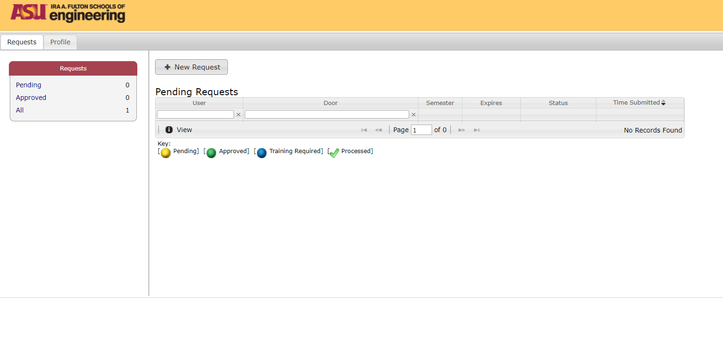
ISAAC Access (Key Fob Request)
Please visit the Fulton ISAAC Access request page to request classroom/building access.
Click +New Request to start your request
Select the Building and Room number(s)
Click Submit

Slide 23
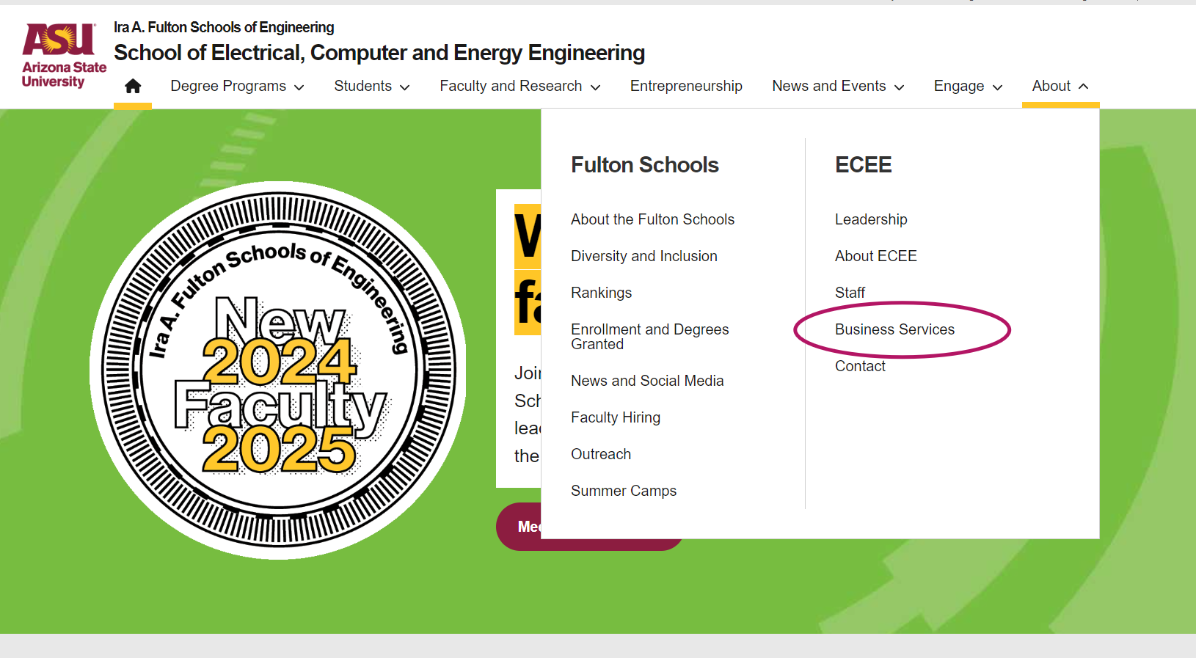
How to find the ECEE Business Service webpage
Notes:
https://ecee.engineering.asu.edu/

Slide 24
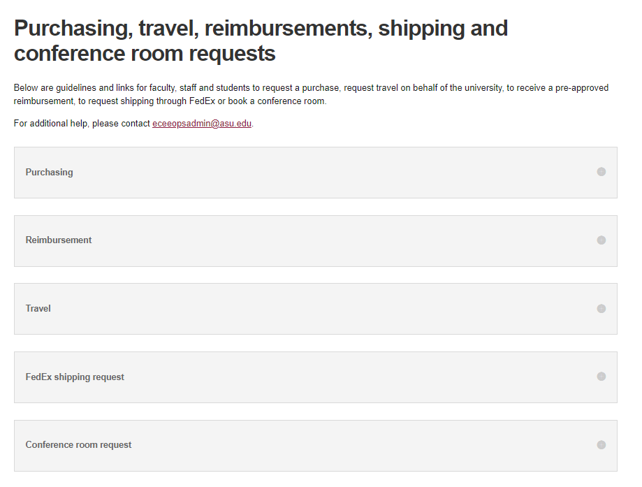
All ECEE Business Ops forms can be found at
ECEE Business Services website. Click here to start
Click the '+' icon to expand and review the Purchase Request instructions, which include a hyperlinked document and detailed guidance

Slide 25
Tips for Purchase Request
A supplier quote must be attached to the request, when applicable.
If no supplier quote is attached to the purchase form, then the supplier catalog # with description, quantity, etc., should be entered on separate lines on the purchase form.
Business purpose: must be clearly stated and provide details the benefit of the purchase.
Example of a Good BP: Biohazard containment system needed to store and organize project samples in Biodesign lab B353.
Examples of a Bad BP: We need a Biohazard containment system
Grant Business Purpose: if the purchase is being made through a grant, please provide details as to how the purchase benefits the grant specifically
After submitting, assign your faculty advisor as 'Participant 2' and their business specialist as 'Participant 3' for routing. A list of faculty and business specialist assignments can be found below the instructions.

Slide 26
Unique Purchase Request
Gas: An ECEE Purchase Request form is still needed to order gas. You can not place this order on your own. To place the order a lab room number is needed.
Computer Hardware/Software: All hardware and software purchases require additional review and approval by the IT department before proceeding with the request.
Orders over 25K: When requesting to purchase an item over 25K, additional quotes from other suppliers will need to be provided, to confirm that a search for the best price and/or best quality was completed.
Orders over 100k: Please contact your PI’s Business Ops specialist for additional forms and details on the process

Slide 27
All ECEE Business Ops forms can be found at
ECEE Business Services website. Click here to start
Click the '+' icon to expand and review the Reimbursement Request instructions, which include a hyperlinked document and detailed guidance

Slide 28
Tips for Reimbursement Request
A Detailed receipt is always needed.
Reimbursements over 1K should be avoided. A strong justification as to why a reimbursement over 1k was needed will be required.
You will not be reimbursed Chemicals, Amazon Orders, Precious gemstones, nor will you be reimbursed for purchases made on a gift card.
Request a reimbursement asap. Requests over 60 days old will be processed through the employee's payroll and will be considered taxable income.
Business purpose: must be clearly stated and provide details the benefit of the purchase.
Example of a Good BP: Registration for Joe Smith to attend annual Nature Conference in Baltimore, MD. Dr. Smith will present his NIH grant research on Identification of Tuberculosis Vaccines in Exosomes.
Examples of a Bad BP: Registration to attend conference
Grant Business Purpose: if the purchase is being made through a grant, please provide details as to how the purchase benefits the grant specifically
After submitting, assign your faculty advisor as 'Participant 2' and their business specialist as 'Participant 3' for routing. A list of faculty and business specialist assignments can be found below the instructions.

Slide 29
All ECEE Business Ops forms can be found at
ECEE Business Services website. Click here to start
Click the '+' icon to expand and review the Conference Room Request instructions, which include a hyperlinked document and detailed guidance

Slide 30
Conference Room Request
Information Needed to complete a room request:
Information Needed to complete a room request:
Room Rules
Purpose of the room request:
Date
Start, time and duration
Will it be reoccurring, if so how frequently
Number of seats needed
Conference Room number (If applicable)
The ASUrite or ASUID of people who need access to the room
After submitting, assign your faculty advisor as 'Participant 2' and their business specialist as 'Participant 3' for routing. A list of faculty and business specialist assignments can be found below the instructions.
No conference room reservations can cross two semesters between normal business hours (Monday – Friday 8:00 am to 5:00 pm).
The Room Requester is responsible for leaving the conference room in the same setup it was in originally (4 tables in a row, 2 chairs to a table, facing the whiteboard in the front of the room). Also, please understand as the room requester it is your job to clean up after you and your attendees – wipe down tables, pick up the floor, and let us know if we need to have staff come vacuum the room.
GWC 487: This room holds up to 70 people and should only be booked for large gatherings like faculty meetings, seminars, workshops, and special events.
No reoccurring meetings in GWC 487. Special circumstances need additional approval from the ECEE Business Ops Department, Business Ops Manager.

Slide 31
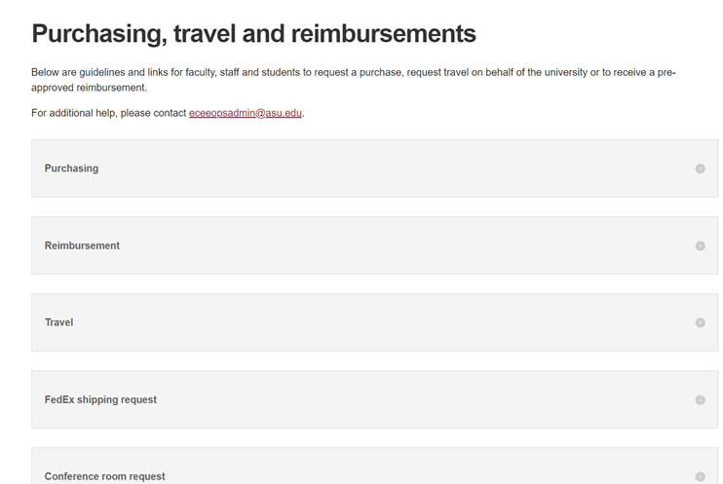
All ECEE Business Ops forms can be found at
ECEE Business Services website. Click here to start
Click the '+' icon to expand and review the FedEx shipping Request instructions, which include a hyperlinked document and detailed guidance

Slide 32
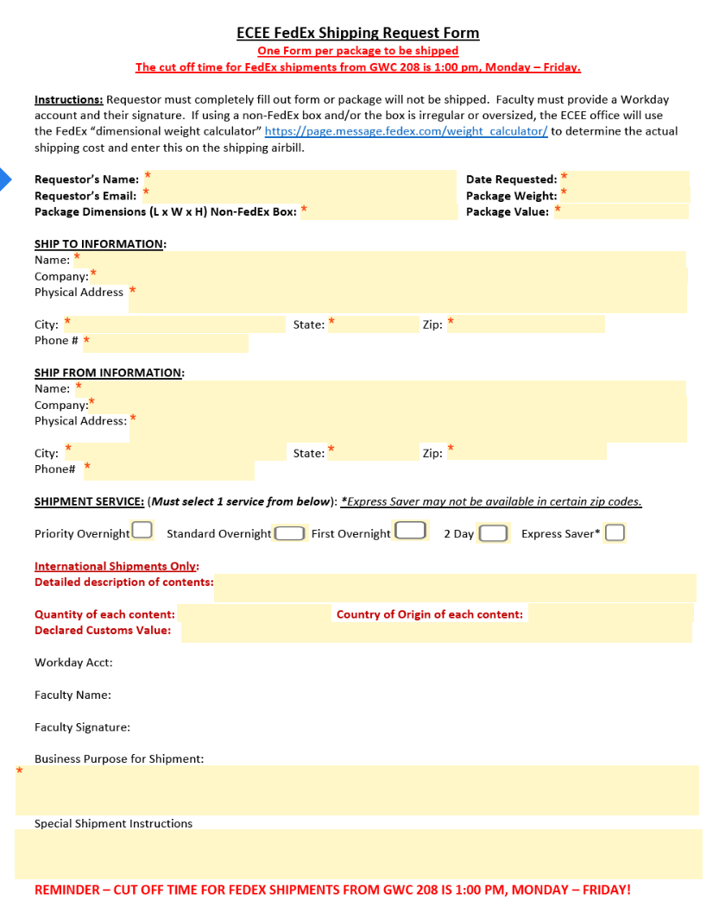
FedEx Shipping Request
FedEx Shipping Request Guidelines (ECEE Account)
Complete the form for each package.
Use separate forms for multiple packages.
For oversized packages, shipping costs will be calculated using FedEx’s dimensional weight calculator.
Once approved, drop off your package at GWC 208 (Mon-Fri, 1:00 pm cutoff).
Use a desktop or laptop to fill out the form; phone browsers are unreliable.
After submitting, assign your faculty advisor as 'Participant 2' and their business specialist as 'Participant 3' for routing. A list of faculty and business specialist assignments can be found below the instructions

Slide 33
Useful links and information
ECEE Business Office Purchasing, Reimbursements, Travel, Room Reservation and FedEx Shipping
Physical Key Request through WebTMA
Door Access with ASU ID Card

Slide 34
Q & A

Slide 35
Thank you for attending
Hosted By Business Operations Team
School of Electrical, Computer, and Energy Engineering

